Slide 1

Section Training for
The Cascades Section of the Oregon Chapter
Madeline Giovagnoli, PE
Oregon Chapter President
Devin Abellon, PE
ASHRAE Vice President
Photo is ASHRAE Headquarters Building
Notes:
Why volunteer?

Slide 2


Slide 3
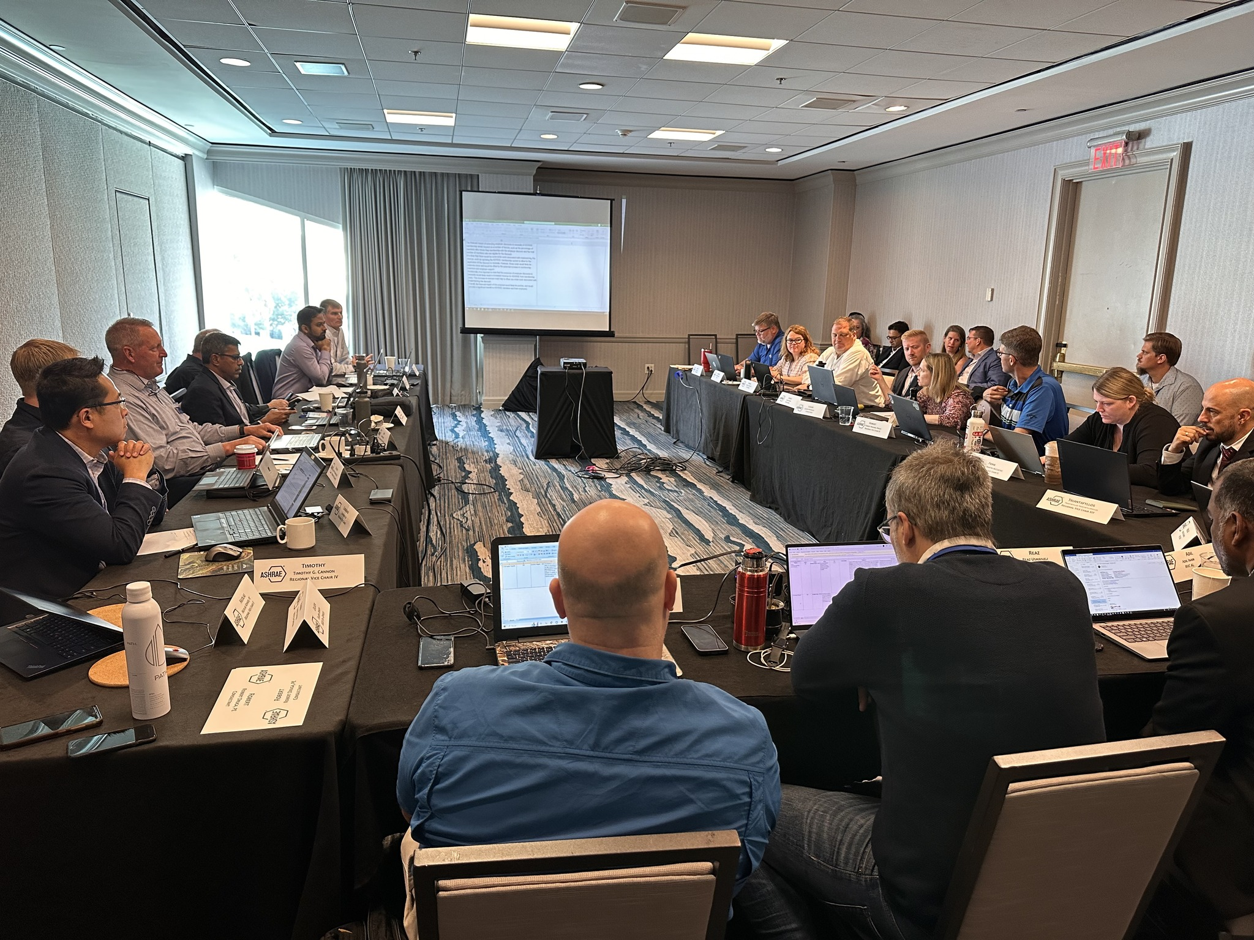

Agenda
Introduction to ASHRAE
The Structure of ASHRAE
  Society
  Region
  Chapter
Running a Section
  Officers
  Meetings / Events
  Finances
  Constant Contact
Policies
Resources
Next Steps

Slide 4
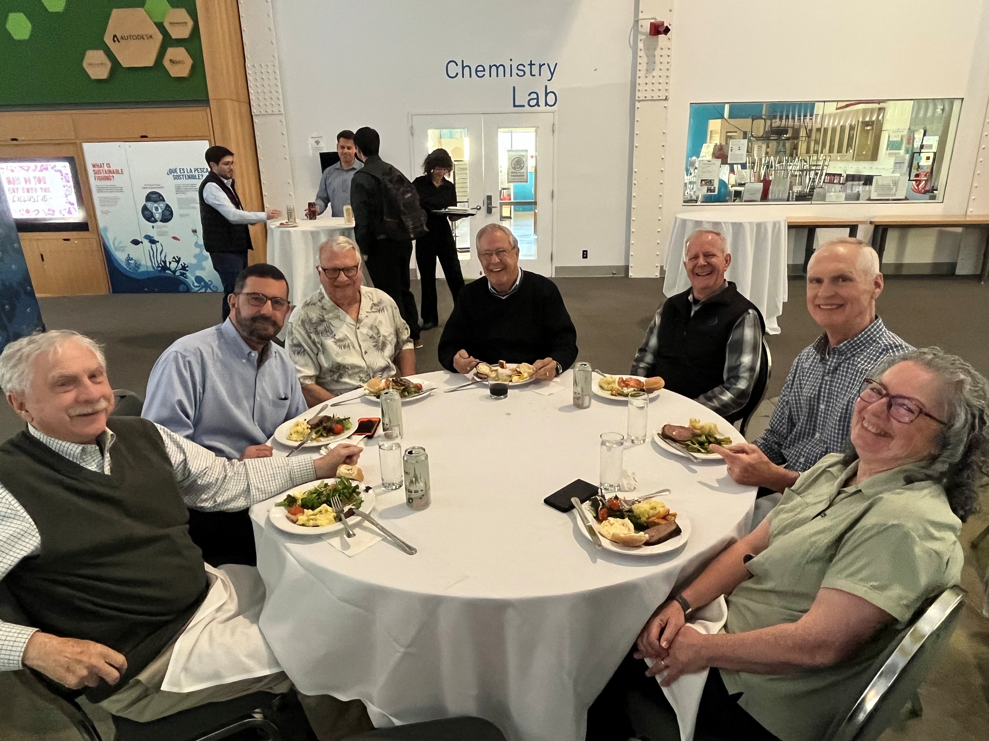

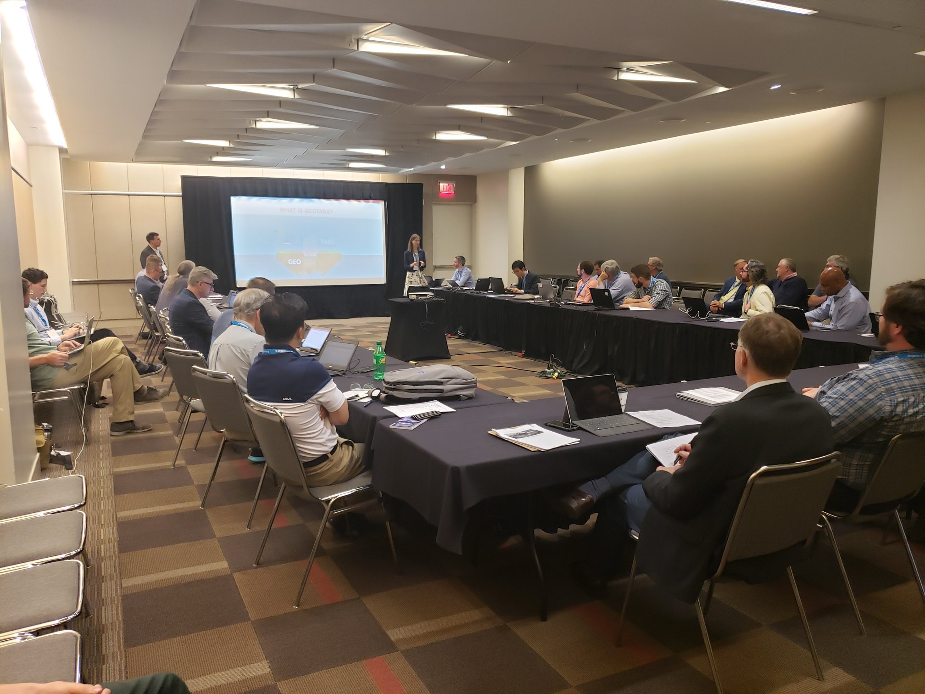
What is ASHRAE?
ASHRAE is a global professional society that develops technical standards and guides for the HVAC&R industry. Its mission is to serve humanity by advancing the arts and sciences of heating, ventilating, air conditioning, and refrigeration to promote a sustainable world. ASHRAE is a key source for information on energy efficiency, indoor air quality, and thermal comfort in buildings.
Notes:
Chapter meetings
Golf networking
Technical committees

Slide 5

ASHRAE Overview
Mission
16 Regions
200+ Chapters
400+ Student Branches
To serve humanity by advancing the arts and sciences of heating, ventilation, air conditioning, refrigeration and their allied fields.
Vision
A healthy and sustainable built environment for all.
Industry Classification
      54,000+ Members
      130+ Countries
Consulting Engineers | Contractors | Manufacturers/Manufacturing Representatives
Government | Health & Education | Design Build | Architects
      100+ Standards
      and Guidelines

Slide 6

What We Do and How We Do It
33 Standing Committees
130+ Standards and
Guidelines Committees
100+ Technical Committees
300+ Publications
7 Certification Programs
200+ Educational Courses
Research
Scholarships
1.
  Serve as pipeline for providing technical information to members, chapters, companies and government officials
  Develop standards and technical guidelines to improve the built environment
  Offer continuing education for industry professionals
  Serve as networking tool for industry professionals
2.
3.
4.

Slide 7

Core Values: ASHRAE’s Foundation
ASHRAE's core values support its mission to advance HVAC&R for humanity's benefit and promote a sustainable built environment.
Learn more at
ashrae.org/corevalues

Slide 8
Key Policies Shaping Our Society
Value Statement
Code of Ethics Commitment
In ASHRAE meetings, we will act with honesty, fairness, courtesy, competence, inclusiveness and respect for others, which exemplify our core values of excellence, commitment, integrity, collaboration, volunteerism and diversity, and shall avoid all real or perceived conflicts of interest. Our culture is one of inclusiveness, acknowledging the inherent value and dignity of each individual. We celebrate diverse and inclusive communities, understanding that doing so fuels better, more creative and more thoughtful ideas, solutions and strategies for the Society and the communities our Society serves. We respect and welcome all.
We will act with honesty, fairness, courtesy, competence, inclusiveness and respect for others, which exemplify our core values of excellence, commitment, integrity, collaboration, volunteerism and diversity, and we shall avoid all real or perceived conflicts of interest.
ashrae.org/codeofethics
Commercialism
Harassment and Discrimination
ASHRAE’s Commercialism Policy allows for Society activities that fulfill the mission of technological advancement with adherence to business plans that generate income to offset operational expenses such as AHR Exposition, ASHRAE periodicals, website, and Society conference events such as the Welcome Party, luncheons, registration kits, and receptions.
ASHRAE strictly prohibits and does not tolerate discrimination against members or applicants for membership because of such individual’s race, color, religion, age, sex, sexual orientation, national origin, physical or mental disability, pregnancy, genetic information, veteran status, uniformed service member status, or any other category protected under applicable law.
ashrae.org/commercialism
ashrae.org/about/governance

Slide 9
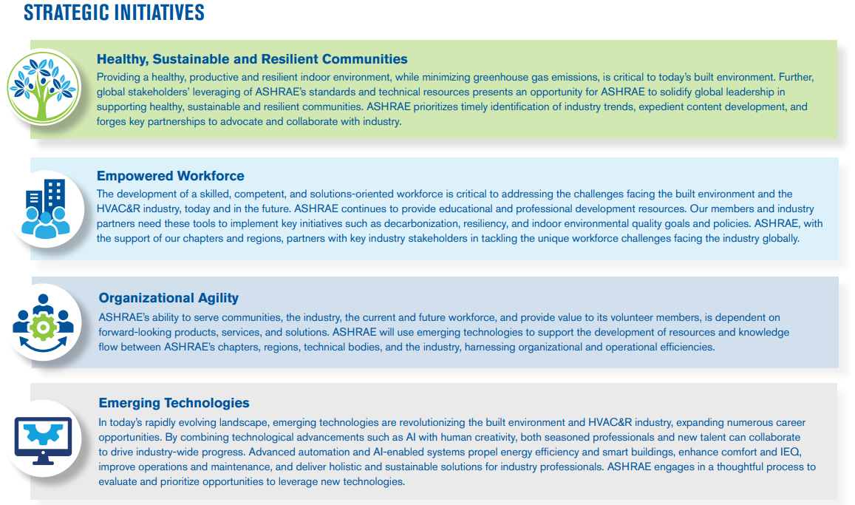
2025-28 ASHRAE Strategic Plan
Download in English and Spanish at ashrae.org/strategicplan
Notes:
The ASHRAE Strategic Plan identifies key priorities for the society over the next three years.
Outcomes
ASHRAE’s member and volunteer base maximizes the organization’s reach, foresight, leadership position, and organizational knowledge.
A broad group of stakeholders leverage ASHRAE's resources to make decisions and meet objectives that positively affect the environment.
A viable, thriving industry makes a positive global impact.
Key Enablers
Research: The value of ASHRAE’s resources is grounded in unbiased data, developed through rigorous research methods.
AI: The use of AI enables ASHRAE to improve data collection, automate internal operations, and promote agility.
Global Network: ASHRAE's global network convenes the industry to generate unparalleled knowledge and content.

Slide 10
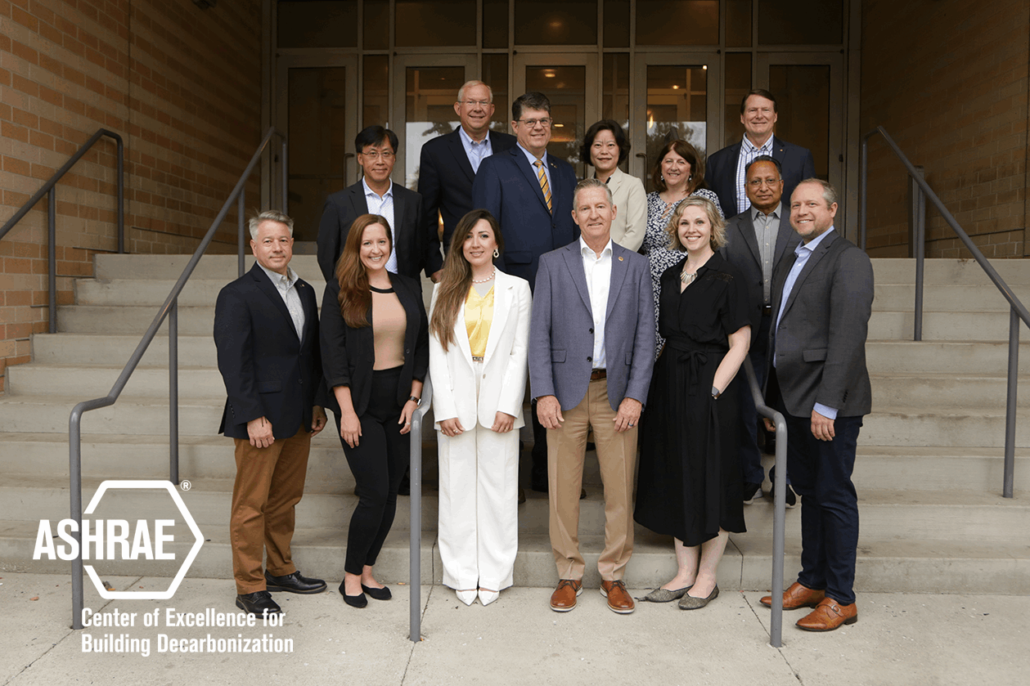
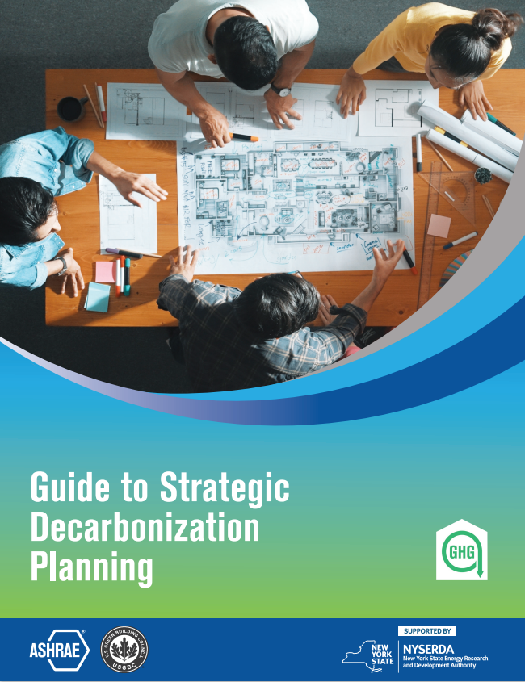


ASHRAE is Focused on Building Decarbonization
CONFERENCES
COMMUNITIES
MEMBERSHIP
Suite of Decarbonization Guides:
  Grid Interactive Buildings for Decarbonization Design
  Decarbonizing Hospital Buildings
  TM65 Addendum for North America with CIBSE
  Building Decarbonization Retrofits for Commercial & Multifamily Buildings
  Decarbonizing Building Thermal Systems: A Guide for Applying Heat Pumps & Beyond with NREL
Videos | Interviews | Publications | Education
Center for Excellence in Building Decarbonization (CEBD)
New Guides & eLearning Course
ashrae.org/decarb
Notes:
ASHRAE recognizes that the scope of building-related policies, programs and regulations needs to expand to incorporate deep energy efficiency improvements, beneficial electrification, demand flexibility, and whole building lifecycle greenhouse gas emission reductions.
To further the Society’s efforts, ASHRAE formed it’s first center of excellence – the “Center for Excellence in Building Decarbonization” (CEBD). The focus of the CEBD is to provide strategic direction on the ongoing efforts of ASHRAE to provide resources for decarbonizing the built environment, on a permanent basis.
ASHRAE’s building decarbonization webpage features resources, including technical guides, video, position documents, related events schedule and media features. Here are some of those resources:
Suite of Decarbonization Guides:
Grid Interactive Buildings for Decarbonization Design
Decarbonizing Hospital Buildings
TM65 Addendum for North America with CIBSE
Building Decarbonization Retrofits for Commercial & Multifamily Buildings
Decarbonizing Building Thermal Systems: A Guide for Applying Heat Pumps & Beyond with NREL
NEW! Whole Life Carbon Guide for Building Systems
NEW! Guide to Strategic Decarbonization Planning with USGBC

Slide 11

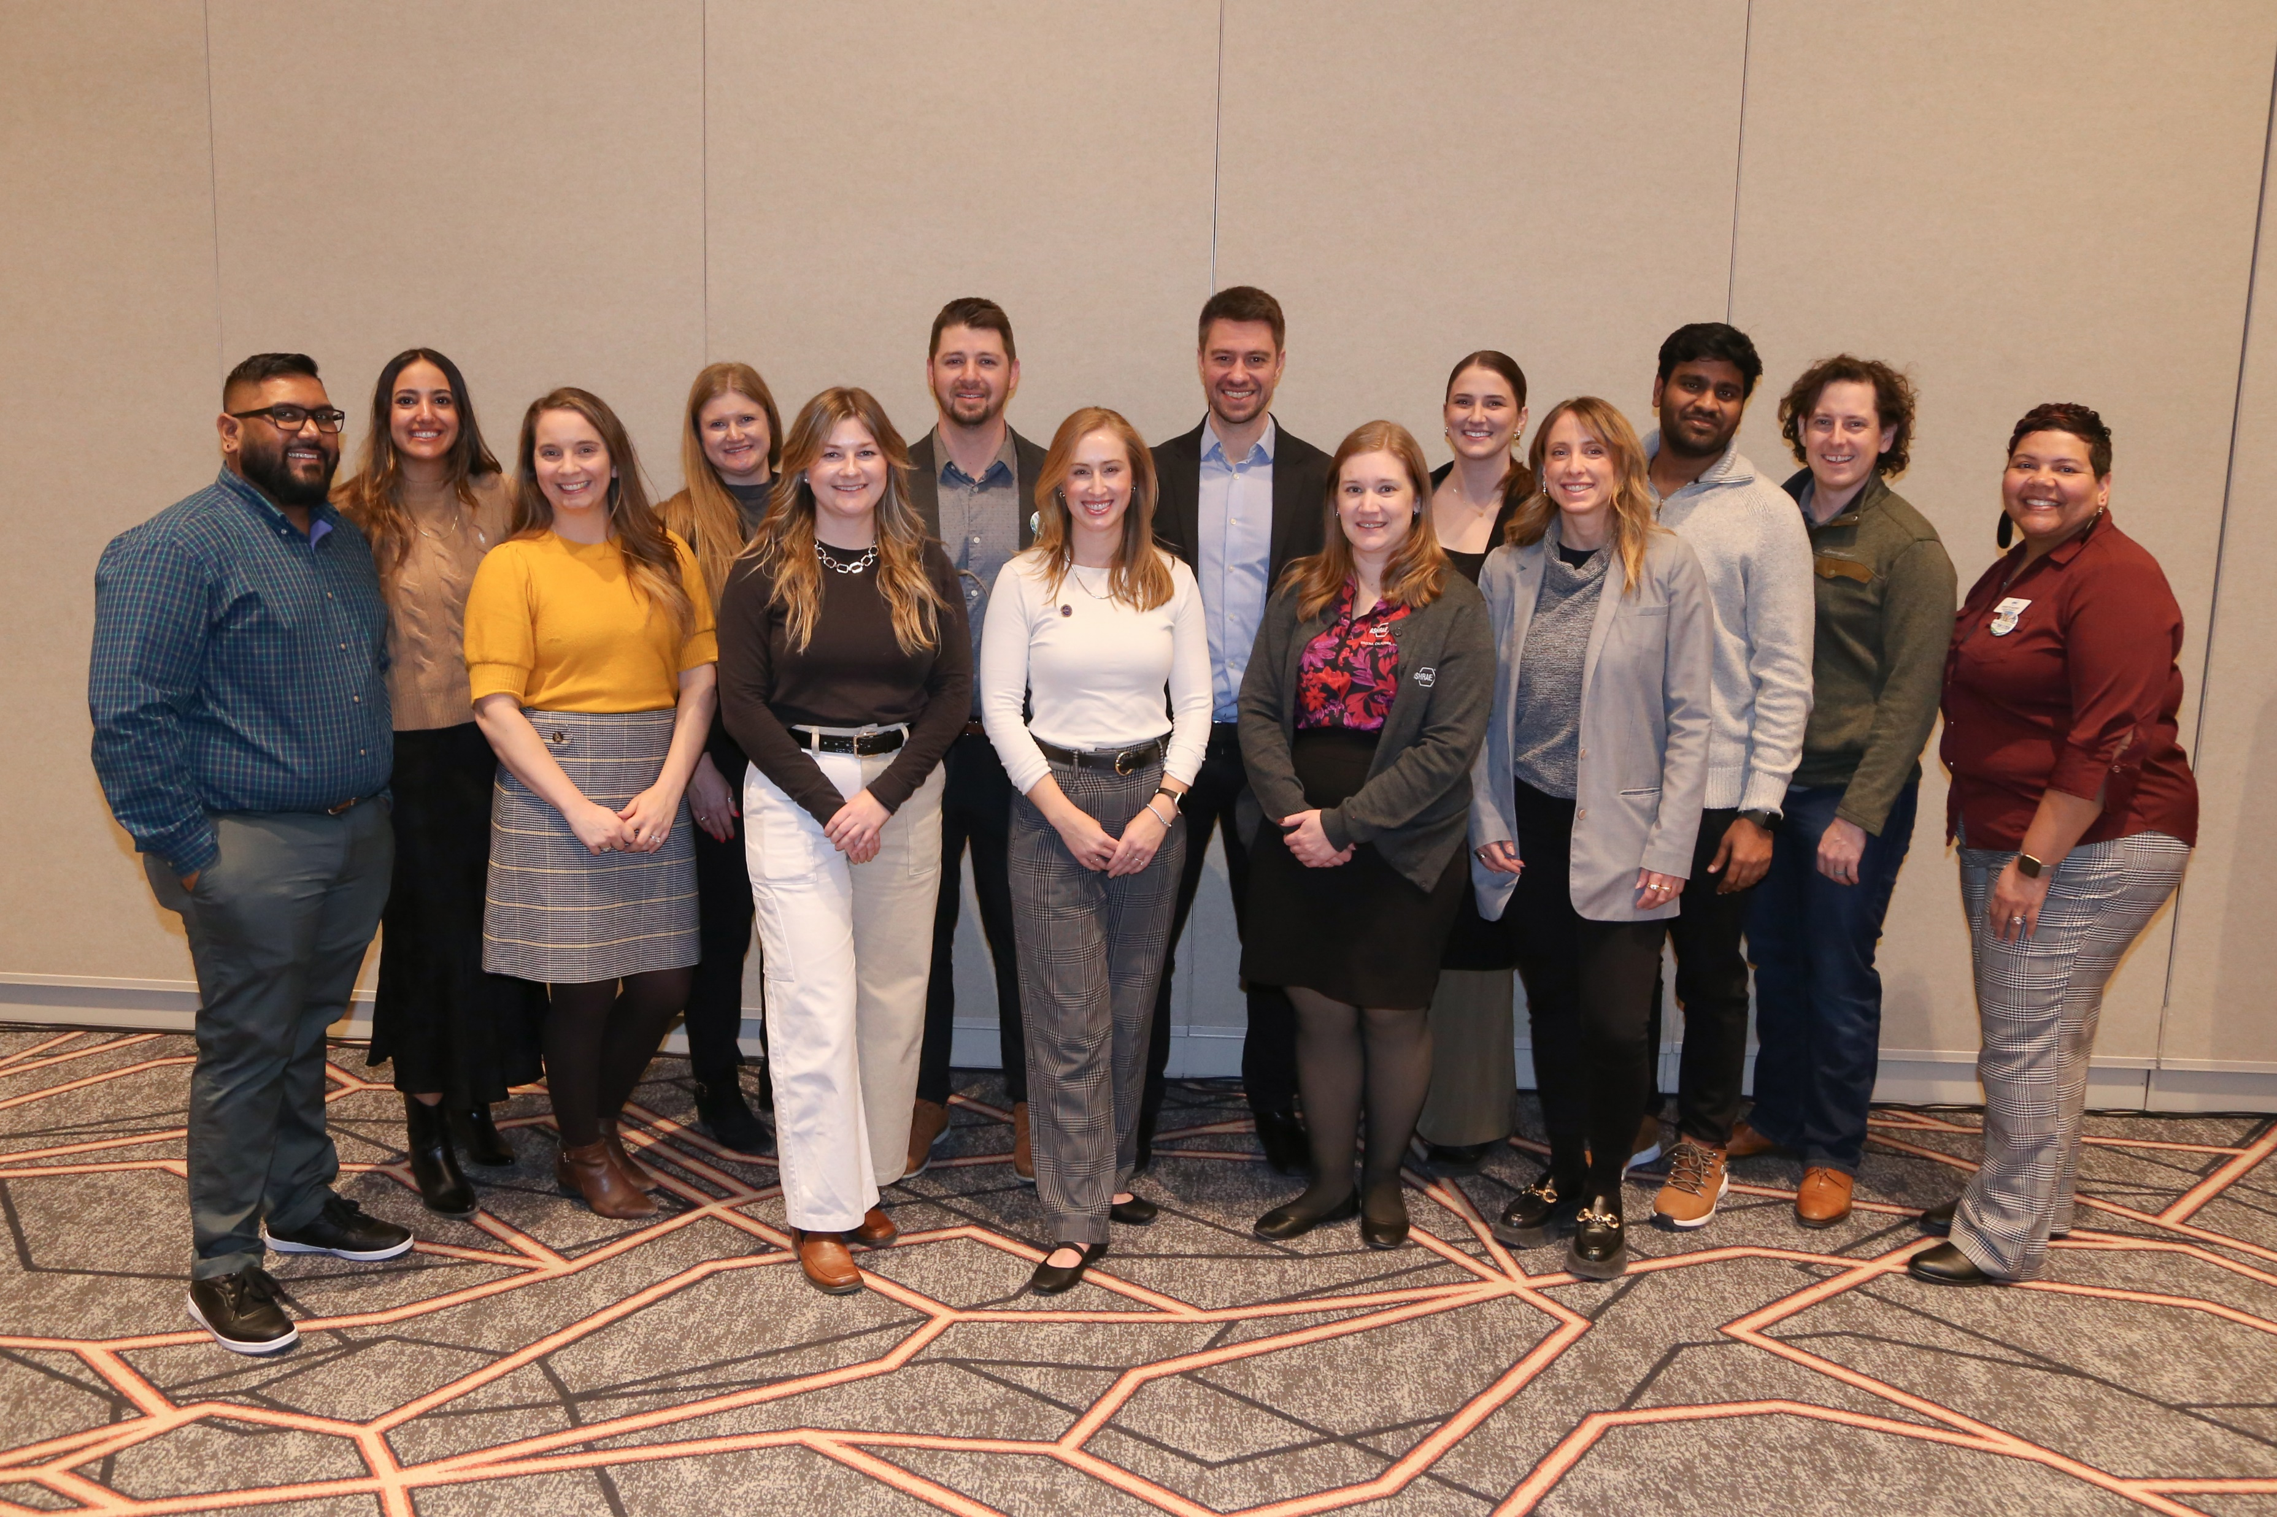
Empowering the Future
The Young Engineers in ASHRAE (YEA) committee focuses on offering relevant programs and services to young professional ASHRAE members, 35 years old and younger.
ASHRAE has a robust Student Program catering to the needs of students at every age. Resources for student members include:
YEA Leadership Weekends
Leadership U
YEA Decarbonization Challenge
YEA HVAC Design Essential Scholarships
Scholarships & Grants
Awards and Competitions
Student Branches
Student Store
ASHRAE also offers resources for K-12 volunteers and educators
ashrae.org/yea
ashrae.org/students
Notes:
A primary focus of the Young Engineers in ASHRAE committee is to attract and develop members for future membership and leadership in ASHRAE and the HVAC&R industry. This is done through an exciting range of events and programming such as:
YEA Leadership Weekends – which provides an opportunity for young engineers to learn more about the Society, develop soft skills and network with other professionals.
Leadership U – where YEA members shadow ASHRAE officers during the ASHRAE Winter and Annual Conferences. LeaDRS is an ASHRAE regional program similar to the Leadership U.
YEA Decarbonization Challenge – was created to align with ASHRAE’s focus on decarbonization. It is a year-long competitive fund ($1,000-$10,000) program granted within local chapters to implement decarbonization projects.
YEA HVAC Design Essentials Scholarships – offers YEA members free registration in ASHRAE’s HVAC Design training courses.
ASHRAE offers a wide variety of programs and resources for K-12 students and educators.

Slide 12
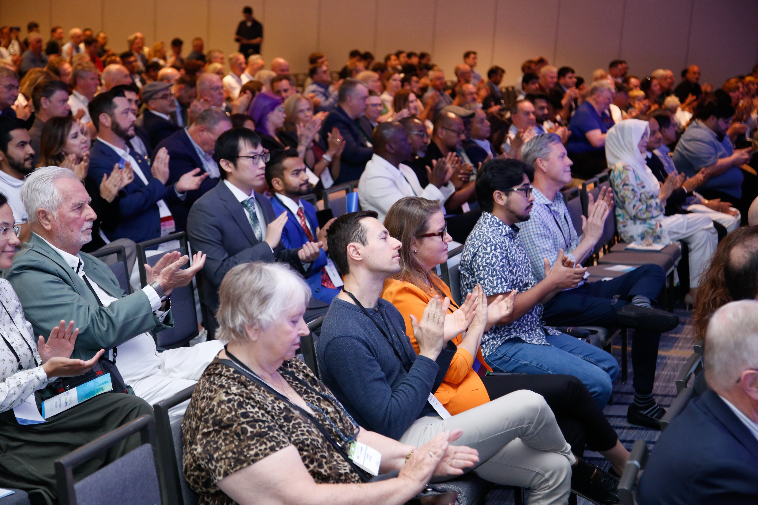
Connecting Minds at ASHRAE Conferences
ASHRAE conferences are tailored to different needs within the HVAC&R and building systems industries. Conferences feature peer-reviewed papers and presentations, and attendees earn professional development hours (PDHs).
Winter & Annual Conferences: ASHRAE major, flagship conferences on HVAC&R trends and research.
Topical Conferences: In-depth focus on specialized industry topics.
Chapter Regional Conferences (CRCs): Annual meetings hosted by ASHRAE’s global regions, providing members a regional platform to learn and network.
Endorsed Conferences: ASHRAE-supported events aligned with the Society’s mission.
ashrae.org/conferences
Notes:
ASHRAE Winter & Annual Conferences: These are the Society's two primary global conferences, attracting HVAC&R professionals, researchers, manufacturers, and policymakers to discuss the latest industry trends and research
Topical Conferences: These are specialized events focused on specific, current, and relevant themes within the HVAC&R and building sciences industries, offering in-depth exploration of a particular subject unlike the broader Winter and Annual conferences
Chapter Regional Conferences (CRCs): These are annual meetings hosted by ASHRAE's 16 global regions, providing members a regional platform to connect with peers and learn about recent industry developments at a local level
ASHRAE Endorsed Conferences: These are events not directly organized by ASHRAE but officially recognized and supported by the Society, signifying their alignment with ASHRAE's mission and technical interests within the HVAC&R field

Slide 13
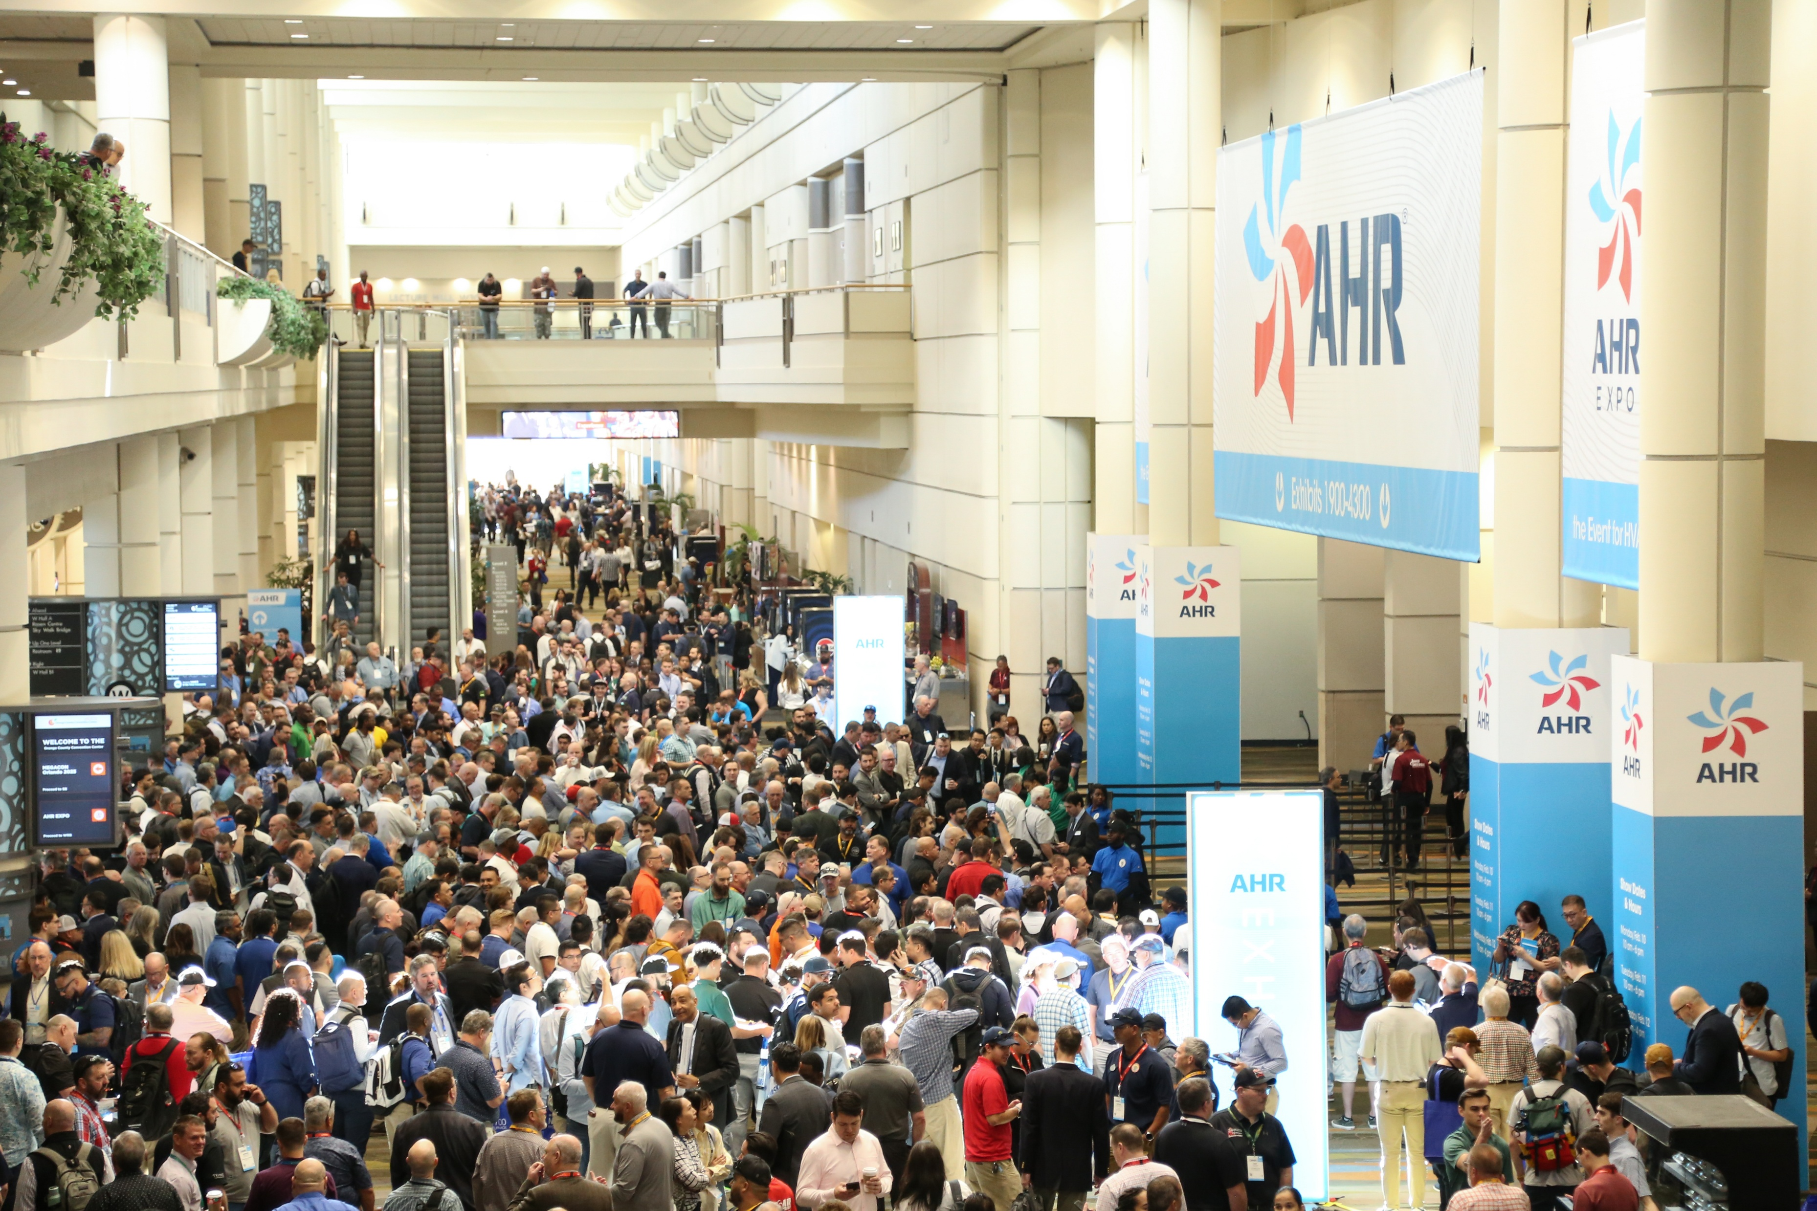





Showcasing Innovation at Leading Industry Tradeshows
ASHRAE is a prominent advocate and participant in industry events and tradeshows. The Society’s participation in these events signifies its commitment to fostering innovation and collaboration with leading industry organizations.

Slide 14



ASHRAE Journal
ASHRAE’s official monthly publication
Provides detailed insight on the latest HVACR technologies and applications for consulting engineers and professionals in the industry.
Articles are peer-reviewed and focus on technical topics, including green buildings, decarbonization, indoor air quality, energy management, thermal storage and alternative refrigerants.
Discussions with leading ASHRAE experts to expand knowledge in the HVACR
industry.
Brief talks with ASHRAE Journal authors on HVACR content published in the Journal.
ashrae.org/ashraejournal

Slide 15

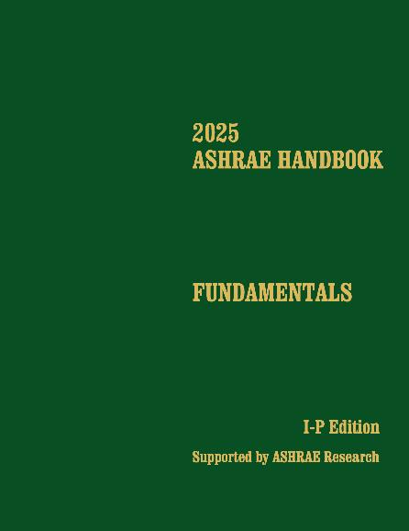
ASHRAE Handbook
ASHRAE Handbook – Print Version
Continuously refined and updated, ASHRAE has published its Handbook series since 1920s
Volumes cover HVAC&R fundamentals, systems, equipment
and a wide variety of applications
Handbooks are also available in the ASHRAE Technology Portal
Available in hardback, PDF, and as an interactive handbook online.
ASHRAE Handbook Online
Mobile device responsive
Content from all four current Handbook volumes plus extra features such as videos, animations, spreadsheets and more
Easier than ever to search across all volumes, print, ask questions about technical content, access bonus features and look up new terminology
Eligible ASHRAE members can choose an ASHRAE Handbook Online subscription at a discounted rate during membership renewal
ashrae.org/handbook
Notes:
The 2025 ASHRAE Handbook—Fundamentals covers basic principles and data used in the HVAC&R industry. Its more than 1,100 pages have been extensively updated and cover foundational concepts such as thermodynamics, psychrometrics, and heat transfer, and provide practical guidance on building envelopes, indoor environmental quality, load calculations, duct and piping system design, refrigerants, energy resources, sustainability, climate change, and more.

Slide 16
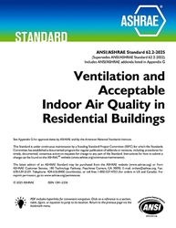
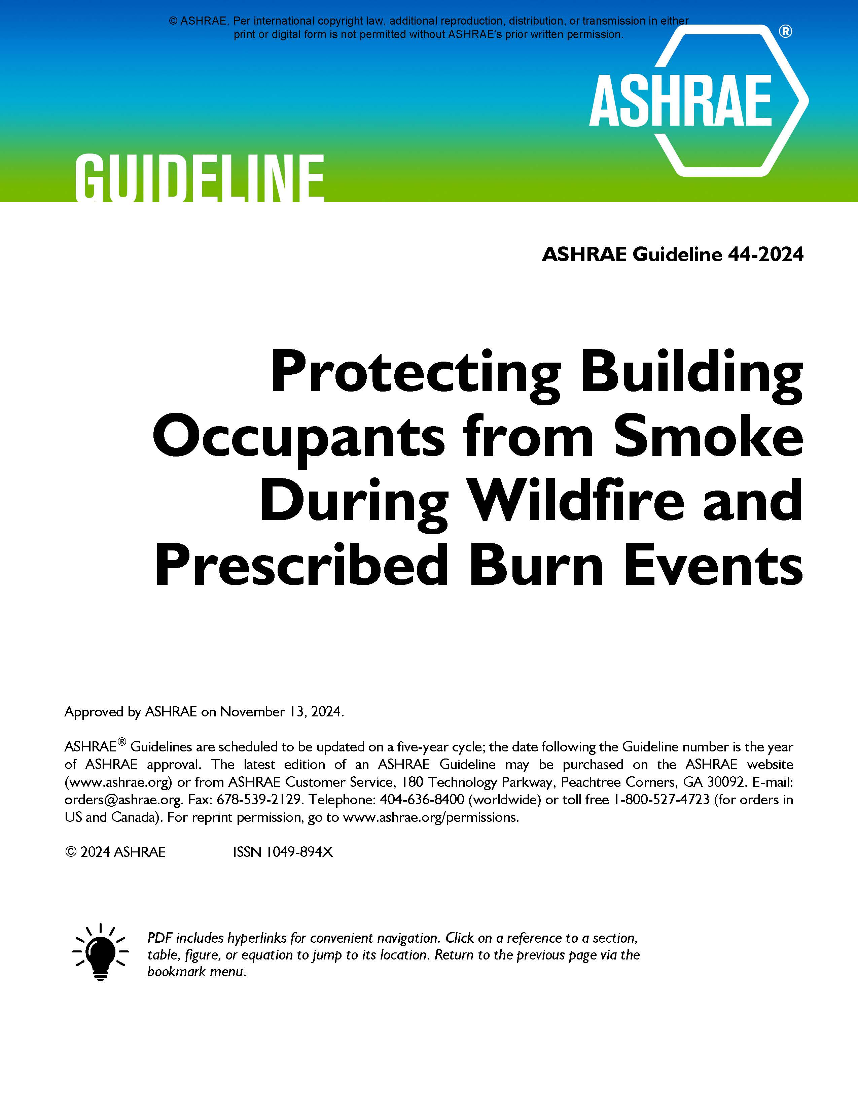
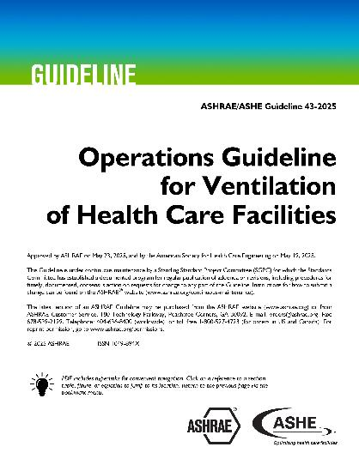
Well-Recognized Standards
PROFESSIONAL DEVELOPMENT
MEMBERSHIP
ASHRAE Standard 15, Safety Standard for Refrigeration Systems and Designation and Classification of Refrigerants
ASHRAE Standard 90.1, Energy Standard for Sites and Buildings Except Low-Rise Residential Buildings
ASHRAE Standard 62.2, Ventilation and Acceptable Indoor Air Quality in Residential Buildings
ASHRAE Standard 34, Designation and Safety Classification of Refrigerants
ASHRAE Standard 55, Thermal Environmental Conditions for Human Occupancy
ASHRAE Standard 62.1, Ventilation for Acceptable Indoor Air Quality
ASHRAE Standard 188, Legionellosis: Risk Management for Building Water Systems
2021 International Green Construction Code (IgCC): Powered by ASHRAE/ICC/USGBC/IES Standard 189.1-2021
ASHRAE Standard 241, Control of Infectious Aerosols
New Edition
Wildfire Resource
New Guideline
ashrae.org/bookstore
Notes:
90.1: Oregon EE Specialty Code based on 90.1

Slide 17
ASHRAE Technical Committee
What do Technical Committees do?
Prepare the text of ASHRAE Handbook chapters
originate, coordinate, and supervise Society-sponsored research projects
present programs at ASHRAE meetings
review technical papers
evaluate the need for standards
Advise the Society on all aspects of the technology it embraces
Technical Committee Sections:
Section 1.0 - Fundamentals and General
Section 2.0 - Environmental Quality
Section 3.0 - Materials and Processes
Section 4.0 - Load Calculations and Energy Requirements
Section 5.0 - Ventilation and Air Distribution
Section 6.0 - Heating Equipment, Heating and Cooling Systems and Applications
Section 7.0 - Building Performance
Section 8.0 - Air-Conditioning and Refrigeration System Components
Section 9.0 - Building Applications
Section 10.0 - Refrigeration Systems
Network, give back and learn. ashrae.org/tcs
Notes:
ASHRAE Technical Committees consist of people who have a recognized proficiency in a specific field of interest. Participation in ASHRAE activities is an excellent way to advance your career – technically, personally, and from a business perspective. If you are involved in the HVAC&R field, or a closely related field, ASHRAE is the go-to organization for professional advancement.
Help ASHRAE shape the industry, advance research, and disseminate critical information.

Slide 18
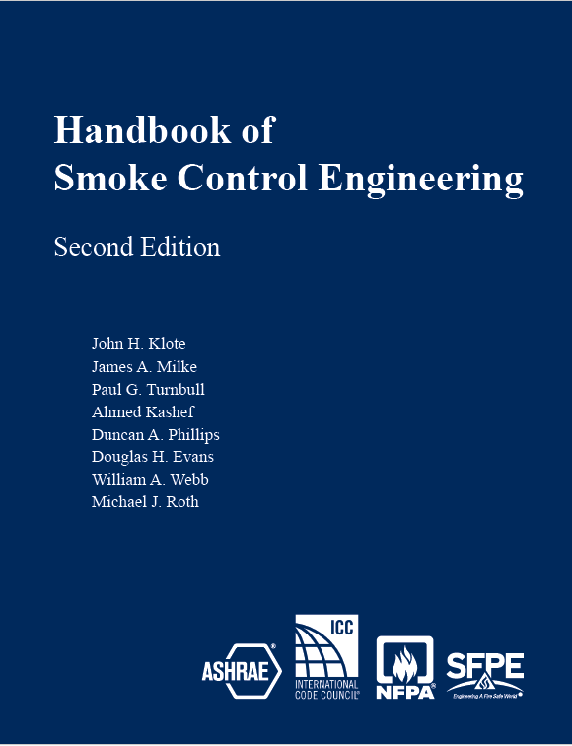
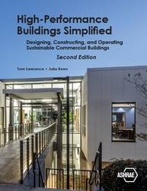

Find Thousands of Publications in the Bookstore
PROFESSIONAL DEVELOPMENT
CONFERENCES
MEMBERSHIP
Get the Latest and most Popular ASHRAE Publications
ashrae.org/bookstore
Notes:
The ASHRAE Bookstore is your go-to resource for industry-leading publications on HVAC&R, building design, energy efficiency and sustainability. Offering a wide range of technical standards, guidelines and educational materials, the bookstore supports professionals at every stage of their careers. Whether you're looking for the latest ASHRAE Standards, comprehensive handbooks or practical guides, the ASHRAE Bookstore has the tools you need to excel in the built environment industry.
Here are some of the latest titles.
Lucy Goes Green
In the second ASHRAE children’s book, Lucy goes with her classmates on a field trip to a sustainable farm, where they learn about using solar panels and windmills and conserving water through rainwater collection.
High-Performance Buildings Simplified
Explore the intricacies of high-performance building design with the newly updated edition of High-Performance Buildings Simplified. Designed for both engineering students and early career professionals, this comprehensive book offers a clear, accessible approach to the fundamental principles of sustainable building practices.
Handbook of Smoke Control Engineering, Second Edition
The most exhaustive and complete treatment of smoke control and related topics in the United States. This handbook is essential for practicing engineers designing smoke control systems or conducting related analyses because it collects all of the necessary information into a single resource of smoke control knowledge.

Slide 19

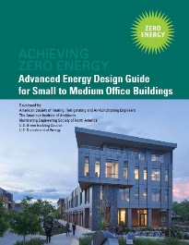


Blueprints for Energy Efficient Building Design
Advanced Energy Design Guides are published in coordination with partners to promote building efficiency.
Building-specific guidance that addresses various project aspects with multiple strategies that move the building design incrementally toward the zero-energy goal.
Zero energy goals and strategies will also move buildings towards decarbonization.
Advanced Energy Design Guide for K-12 School Buildings – Achieving Zero Energy
Applicable to all sizes and types of K-12 school construction.
Advanced Energy Design Guide for Small to Medium Office Buildings – Achieving Zero Energy
Applicable to office buildings 10,000 to 100,000 ft² with a building height of less than 75 feet.
Advanced Energy Design Guide for Multifamily Residential Buildings – Achieving Zero Energy
Applicable to construction of new multifamily buildings covered by ANSI/ASHRAE/IES Standard 90.1
ashrae.org/freeaedg
Notes:
The ASHRAE Advanced Energy Design Guides (AEDGs) are a series of publications that provide practical recommendations for achieving significant energy savings in various types of buildings. Developed in collaboration with industry experts, these guides offer strategies that are both cost-effective and easy to implement, with the goal of helping design teams create buildings that use 50% or 30% less energy than typical buildings. The AEDGs cover a wide range of building types and climates, making them valuable resources for architects, engineers and other professionals committed to sustainable design and energy efficiency.

Slide 20


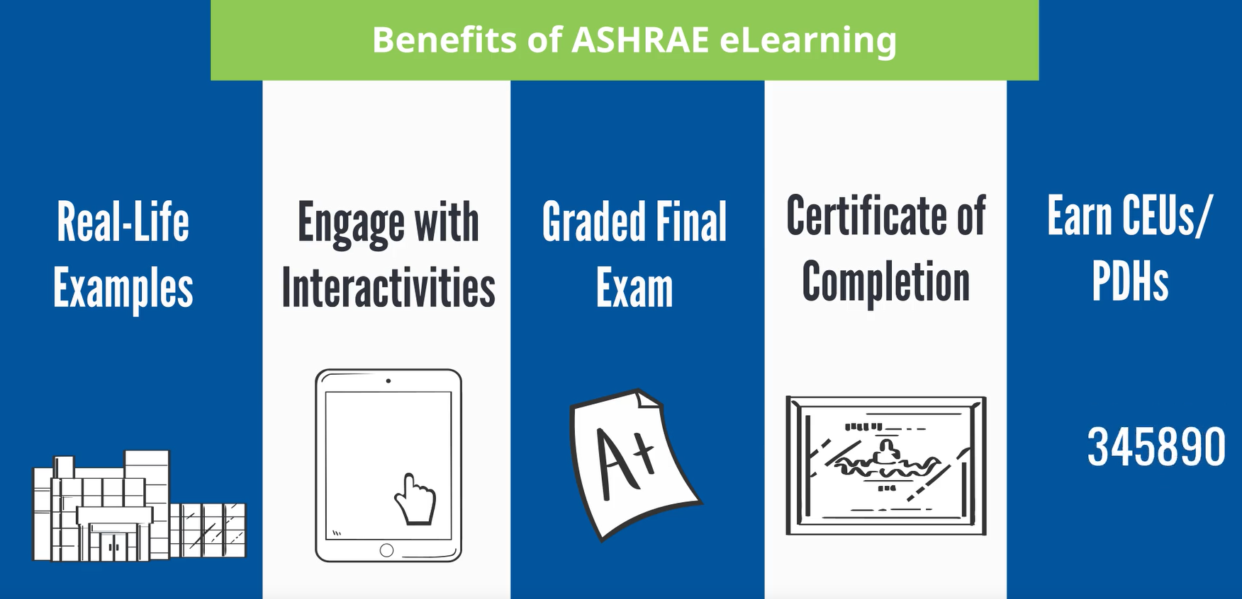
Stay Ahead of the Curve With
ASHRAE Professional Development
Sign up for the latest offerings
MEMBERSHIP
ASHRAE offers a wide range of professional development opportunities to ensure that professional remain at the forefront of industry advancements and best practices.
In-person and group training for companies and Chapters is available.
ashrae.org/education
eLearning
ASHRAE Learning Institute
Certification
7 Certifications​
Over 90 eLearning courses available
Notes:
ASHRAE's Professional Development programs provide industry-leading opportunities to enhance your career in HVAC&R and building sciences. Offering a variety of resources—including eLearning courses, certifications and hands-on instructor-led training—ASHRAE helps professionals stay ahead of the curve in technological advancements and industry best practices. Whether you aim to sharpen your technical expertise, develop leadership skills, or stay current with the latest standards, ASHRAE's comprehensive professional development offerings are designed to empower you to achieve your career goals and make a meaningful impact on the built environment.

Slide 21
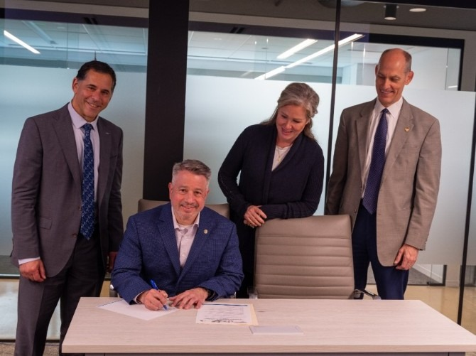
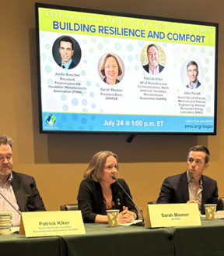
Shaping Policy with
ASHRAE Government Affairs
The mission of ASHRAE’s Government Affairs office is to establish ASHRAE as a leading source for expertise in the built environment and a resource for policy-makers in the development of legislation and regulations affecting the public, the HVAC&R community, and the engineering profession.
Stay Informed with our bi-weekly Government Affairs Update.
Sign up online ashrae.org/newsletters or email GovAffairs@ashrae.org
South America
Government Outreach Events connect ASHRAE volunteers with elected officials, government agencies, and aligned organizations.
ASHRAE’s Public Policy Priorities:
  Support Sustainable Building Practices including Building Decarbonization to
  Mitigate Climate Change
  Promote Healthy Buildings and Reduce Indoor Environmental Risks
  Advance Design and Construction of Resilient Buildings and Communities
  Ensure the Orderly and Safe Phasedown of High-GWP HFC Refrigerants
  Support Adoption of the Latest Edition of ASHRAE’s Energy Standards into Building Codes
  Strengthen and Increase Diversity in the HVACR Workforce
Canada
Canada
United States
South America
ashrae.org/government-affairs

Slide 22




Stay Current with the ASHRAE 365 App
ASHRAE 365 is a free app providing year-round
updates on all things ASHRAE. Download in your app store.
Learn more at ashrae.org/365.
Notes:
Home section where you can view the latest alerts, current promotions, and set up your personalized My Shortcuts to access the information most important to you.
Events section where you can find information on ASHRAE Conferences, Chapters Regional Conferences, Topical Conferences, Events Calendars, and Virtual Conferences as well as access exclusive technical content from ASHRAE Tech Hour.
Connect section providing notifications and news pertinent to the Society and quick access to all of ASHRAE’s social media. Ability to direct message with fellow conference attendees.
Membership & Support section offering leadership information, ASHRAE Chapter details, Distinguished Lecturers program resources, information on how to support the Society through donations or volunteering, and how to get in touch.
Resources section with access to ASHRAE volunteer resources, Standards and Guidelines information, continuing education courses as well as search features for industry jobs and materials to help you engage others with ASHRAE.

Slide 23


You Can Help Support ASHRAE’s Mission
ASHRAE Development supports
Technical Research
Programs for Young Engineers in ASHRAE (YEA)
Courses for ASHRAE Learning Institute (ALI)
Scholarships
General fund
Fundraising Totals for SY 2024-25
$4.825M
Learn More and Donate at ashrae.org/development
Notes:
ASHRAE's mission is supported through donations that fund both development and research promotion efforts. Donations help technical research, education and professional development, scholarships and other efforts that drive innovation in HVAC&R technologies and practices. By supporting these areas, donations enable ASHRAE to advance industry knowledge, improve practices, and promote sustainable and efficient HVAC&R solutions.

Slide 24
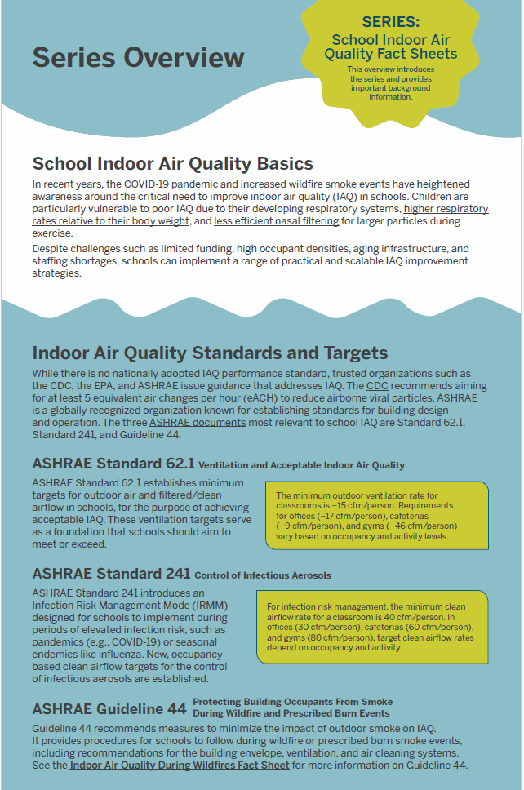


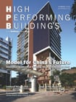



Find Resources and Stay In the Know
Get FREE resources for professionals, educators and consumers at ashrae.org/freeresources
Sign up to get ASHRAE Newsletters for the latest Society and industry updates at ashrae.org/newsletters

Slide 25
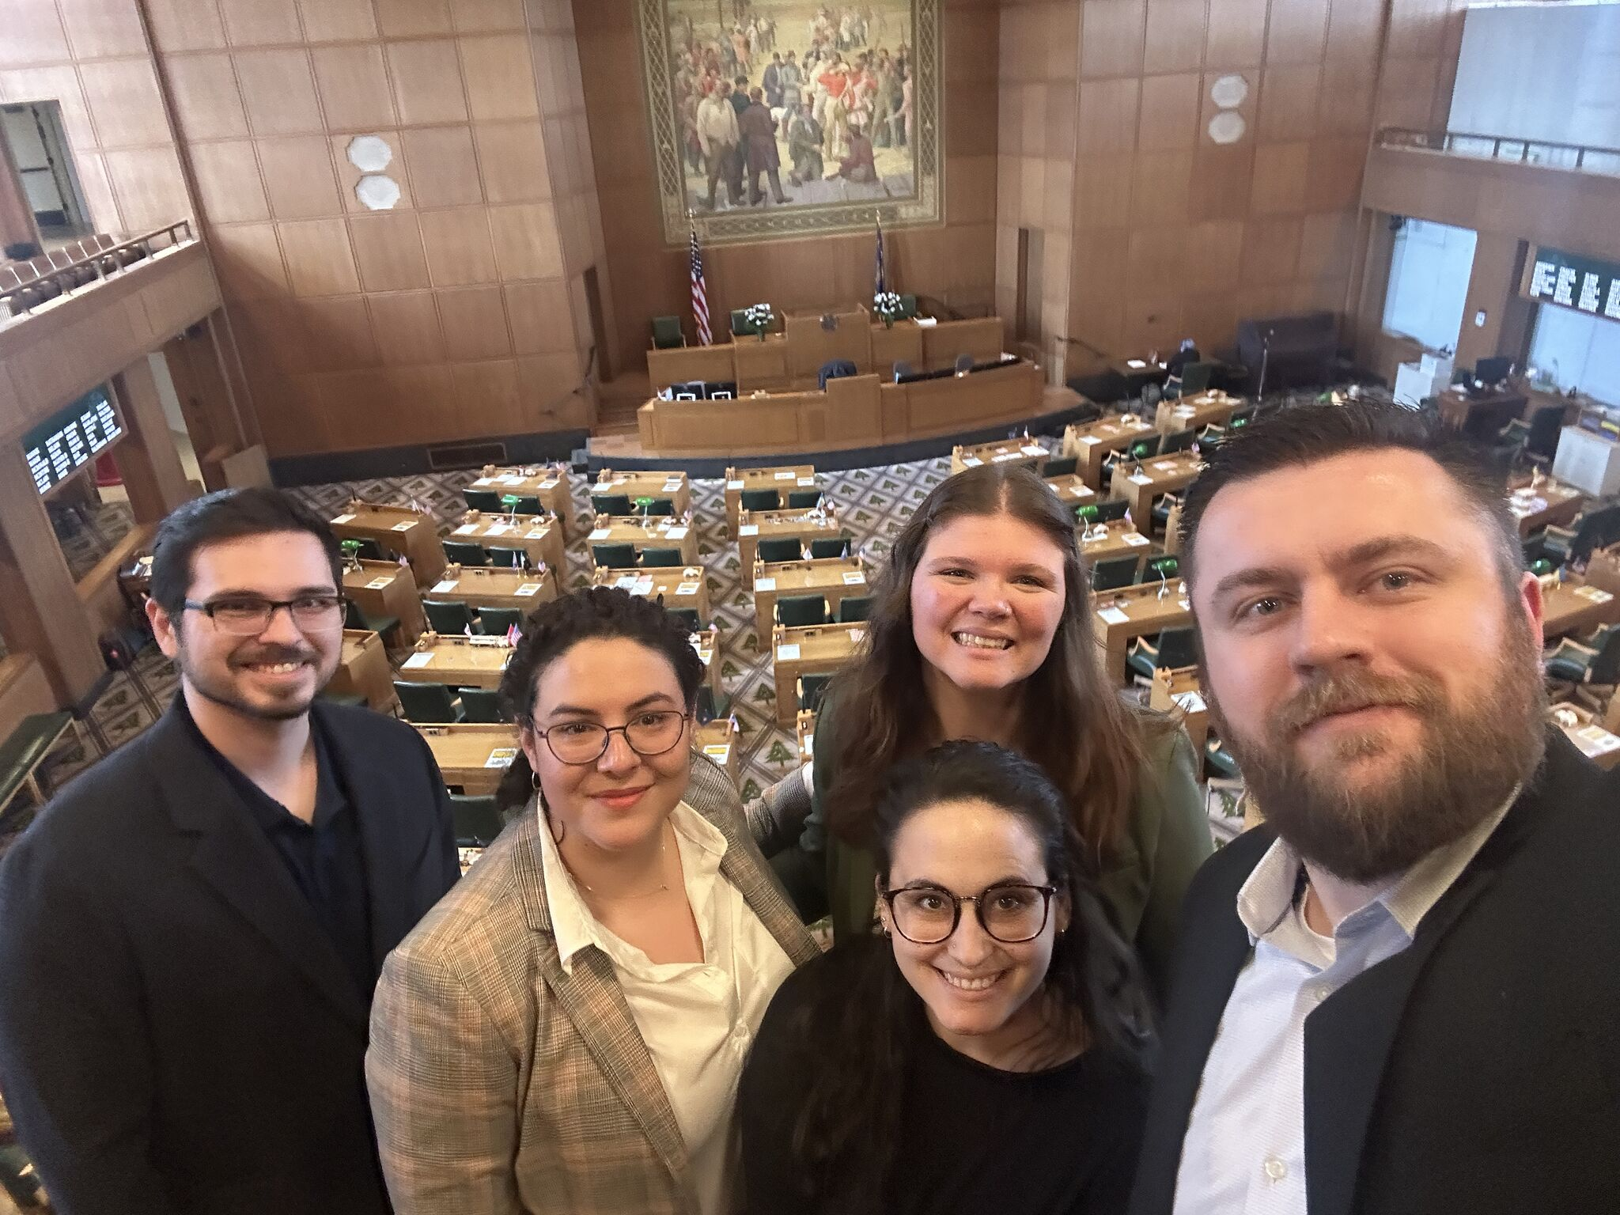
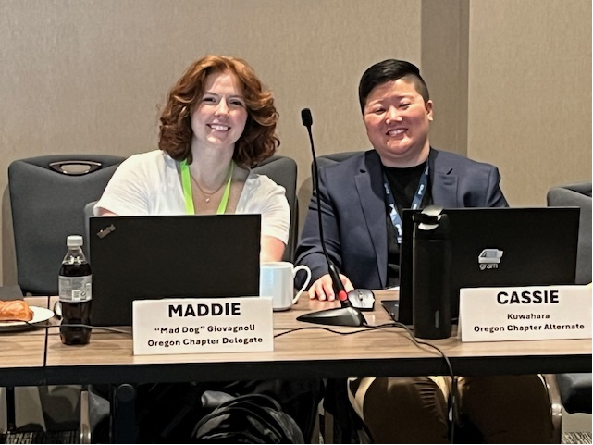
You Can Make a Difference Now!

Slide 26


The Structure of ASHRAE
Most members are assigned to a Chapter
Each Chapter is assigned to a Region
Each Region is represented on Members Council and Society’s Board
ASHRAE is member-driven and relies heavily on its grassroots
1 Society
16 Regions
200 Chapters
54,000 Members
Notes:
As you just saw, Rather than start from the top down, ASHRAE is organized from the bottom up – starting with members, and the Chapters they belong to.

Slide 27
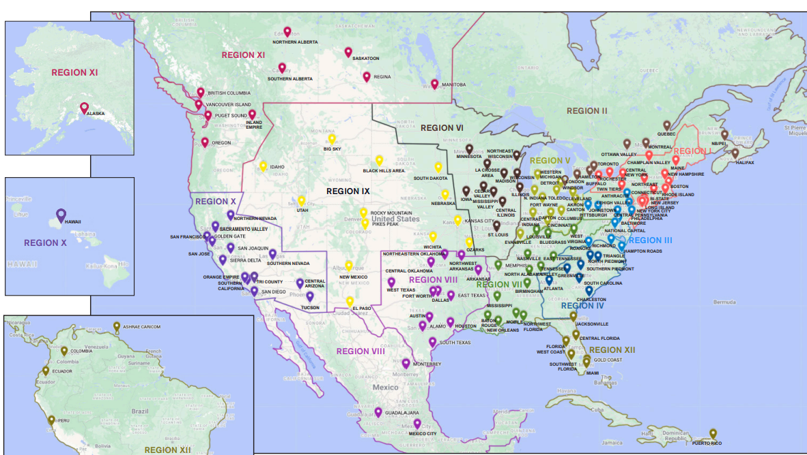
Regions I – XII: US, Canada, Central and South America

Slide 28
Regions I – XII: US, Canada, Central and South America

Slide 29











Region XI

Slide 30
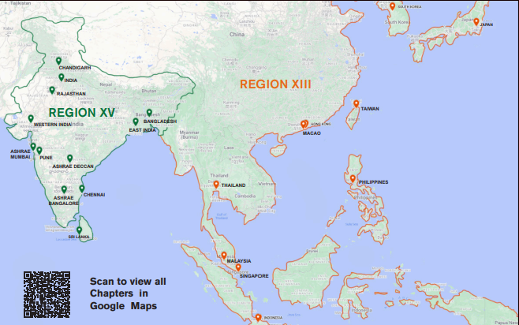
Region XIII: Far East
Region XIII Chapters
Hong Kong
Indonesia
Japan
Macao
Malaysia
Philippines
Singapore
South Korea
Taiwan
Thailand

Slide 31
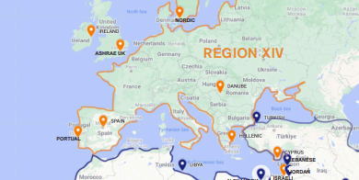
Region XIV: Europe
Region XIV Chapters
Cyprus
Danube: Austria/Bulgaria/Croatia/Czech Republic/Germany/Romania/Serbia/Slovenia
Greece
Israel
Spain
Portugal
UK
Ireland
Nordic
Sections: Belgium, France, Germany, Italy, Scotland, UK Northern, Northern Helles

Slide 32
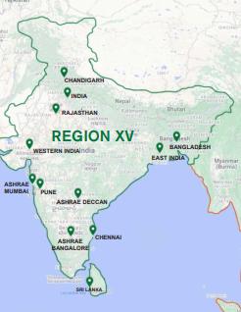
Region XV: India
Region XV Chapters
India (10)
Notes:
Effective July 1, 2024. Formally Sub-Region 2 of RAL.

Slide 33
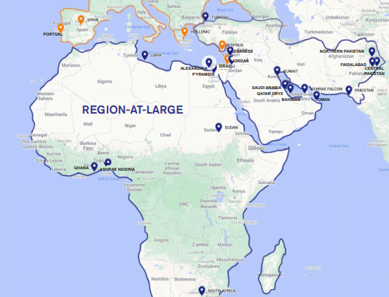
Region-at-Large: Africa and Middle East
RAL Chapters
Bahrain
Egypt (3)
Jordan
Kuwait
Lebanon
Nigeria
Pakistan (4)
Qatar
Saudi Arabia
South Africa
Turkey
UAE
Ghana
Libya
Sudan
Bangladesh
Sri Lanka

Slide 34




The Structure of ASHRAE
Society
Region XI

Slide 35
ASHRAE Organizational
Chart
ExCom
AASA
ASHRAE Membership
Strategic Industry Advisory Group
Development Committee
BOD
Finance Committee
Planning Committee
Foundation Trustees
Audit Committee
Nominating Committee
DEI Advisory Subc
Scholarship Trustees
Society Rules Committee
Members Council
Technology Council
Publishing and Education Council
CTT Committee
Environmental Health Committee
Certification Committee
Communications Committee
Refrigeration Technology Committee for Comfort – Process – Cold Chain
Handbook Committee
CEC
JEPC
Research Administration Committee
Historical Committee
Life Members Club
Technical Activities Committee
Training and Education Committee
H&A Committee
College of Fellows
Publications Committee
MP Committee
Residential Buildings Committee
RP Committee
Standards Committee
SA Committee
Global Technical Interaction Committee
YEA Committee
GA Committee

Slide 36

Board of Directors
President
President -Elect
Executive Committee
Officers
Treasurer
Secretary
(ASHRAE Staff)
Vice Presidents (4)
Directors
Director and Regional Chairs (16)
Directors-at-Large (9)

Slide 37

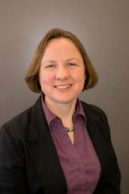

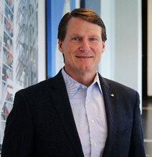
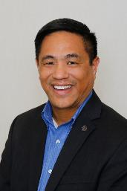
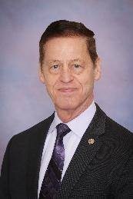


ASHRAE Board of Directors – ExCom
President
President-Elect
Treasurer
Secretary
Bill McQuade, P.E.
CDP, Fellow ASHRAE, LEED AP
Jessup, Maryland
Sarah Maston, P.E., BCxP, LEED AP
Hudson, Massachusetts
Ashish Rakheja, B.E., M.Tech, Fellow ASHRAE
Uttar Pradesh, India
Jeff Littleton
Peachtree Corners, Georgia
Vice Presidents
Kenneth Fulk, P.E.
Allen, Texas
Trent Hunt, Fellow ASHRAE
Midvale, Utah
Andres Sepulveda, P.E.,
Fellow ASHRAE
Madrid, Spain
Devin Abellon, P.E.
Portland, Oregon

Slide 38







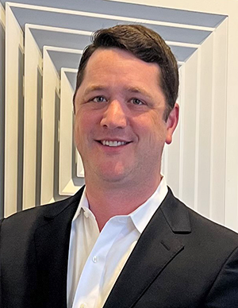
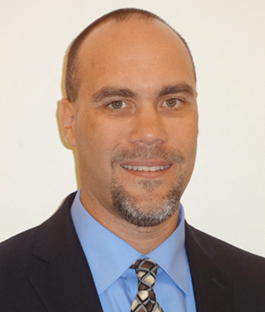


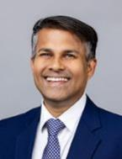
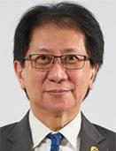
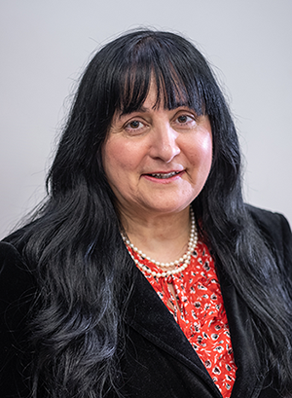


ASHRAE Board of Directors – Directors & Regional Chairs (DRCs)
Region I
Region II
Region III
Region IV
Region V
Charles Bertuch
Manlius, New York
Genevieve Lussier
Quebec, Canada
Sherry Abbott-Adkins, P.E., CPD, GPD, LEED AP Westminster, Maryland
Heather Platt Gulledge, P.E., MBA
Summerfield, North Carolina
Julia Timberman, P.E.
Columbus, Ohio
Region VI
Region VII
Region VIII
Region IX
Region X
Maggie Moninski, P.E., LEED AP, BD+C
Chicago, Illinois
Scott Peach, P.E.
Mobile, Alabama
Joseph Sanders
Oklahoma City, Oklahoma
Jonathan Smith, P.E. Kansas City, Missouri
Buzz Wright, P.E.
Tucson, Arizona
Region XI
Region XII
Region XIII
Region XIV
Region XV
Region-at-Large
Submit nominations for others and/or yourself
ashrae.org/committee-nominations
Ching Loon Ong, P.E., CMVP, Hon Fellow AFEO
Subang, Jaya, Malaysia
Bassel Anbari, P.E.
Abu Dhabi, United Arab Emirates
Rob Craddock
Saskatchewan, Canada
Jason Alphonso, P.E., OPMP, PMP
Winter Park, Florida
Mahroo Eftekhari, CEng., DPhil
Loughborough, UK
Pankaj Dharkar, Fellow ASHRAE
Ahmedabad, India

Slide 39
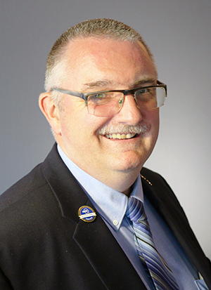
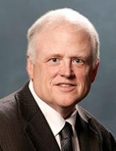
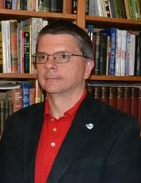



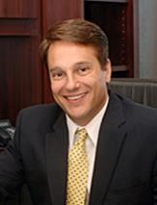
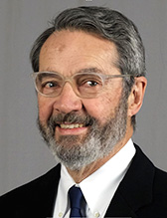

ASHRAE Board of Directors – Directors at Large (DALs)
Doug Cochrane, P.Eng., CDP
Mississauga, Ontario, Canada
Steve Kujak
Brownsville, Minnesota
Patrick Marks, P.E.
York, Pennsylvania
Corey Metzger, P.E.
Papillion, Nebraska
Carrie Brown, Ph.D.
Oakland, California
Mike Pouchak, P.E., Fellow ASHRAE
St. Anthony, Minnesota
David Yashar, Ph.D., Fellow ASHRAE
Gaithersburg, Maryland
Daniel Nall
Princeton, New Jersey
Martin Dieryckx
Ostend, Belgium
Submit nominations for others and/or yourself
ashrae.org/committee-nominations

Slide 40
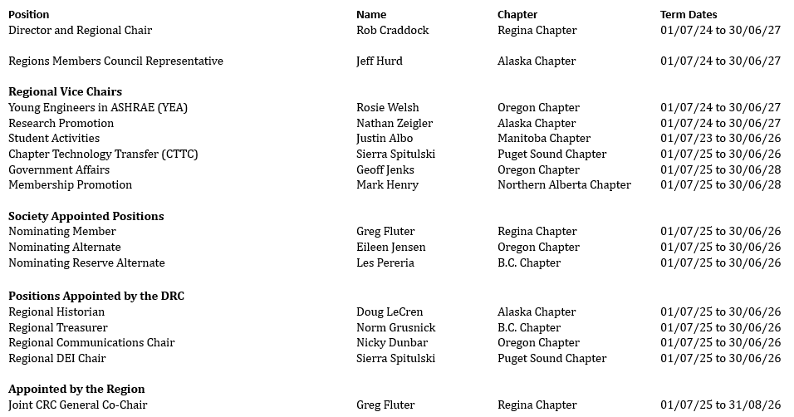
Region XI Leadership
Region XI
Rob Craddock
Saskatchewan, Canada

Slide 41
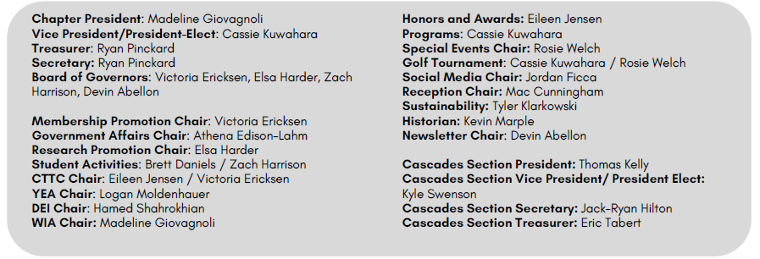

Chapter Leadership
Oregon Chapter
Madeline Giovagnoli
Portland, Oregon

Slide 42

Chapter Organization
ASHRAE Membership
Chapter Membership
Responsible for
Budget
Oversight
Decisions
Support for committees
Standing Committees
  CTTC
  RP
  GAC
  MP
  YEA
  SA
  Historical
  Communications
Board of Governors:
Elected by chapter members
  President
  President-Elect
  Vice President (optional)
  Secretary
  Treasurer
  BOG Members
Other Committees
  Sustainability
  Diversity
  H&A

Slide 43
Chapter Committees
Chapter Technology Transfer Committee (CTTC)
Develops chapter programs, coordinates research and technical awards
Government Affairs Committee (GA)
Advocates to local governments and organizations
Research Promotion (RP)
Solicits funds for ASHRAE Research, Education, Scholarships, YEA
Informs members of research
Communications (formerly Electronic Communications)
Handles website, meeting registration, communications
Membership Promotion (MP)
Tracks, serves, and encourages active membership
Student Activities Committee (SA)
Involves local schools: K-12, post-high; scholarships
Young Engineers in ASHRAE (YEA)
Promotes activities for members < 35 years of age
History
Submits yearly history for Chapters Regional Conference (CRC)
Honors and Awards (H&A)
Tracks Chapter Activities
Nominates Chapter Members for Awards
Newsletter
Informs members of activities, chapter news
Diversity in ASHRAE / Women in ASHRAE
Promotes diversity and inclusion within the chapter
Nominating
Identifies future chapter leaders
CRC Action
  Prepares chapter leaders for CRC

Slide 44
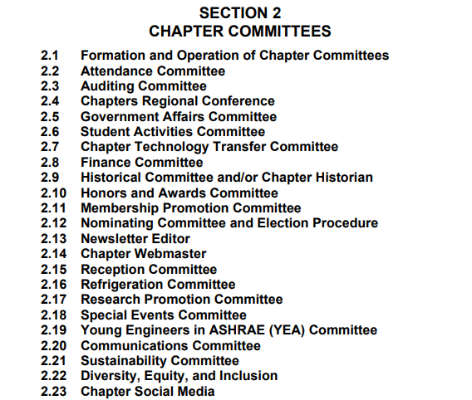
Chapter Committees

Slide 45
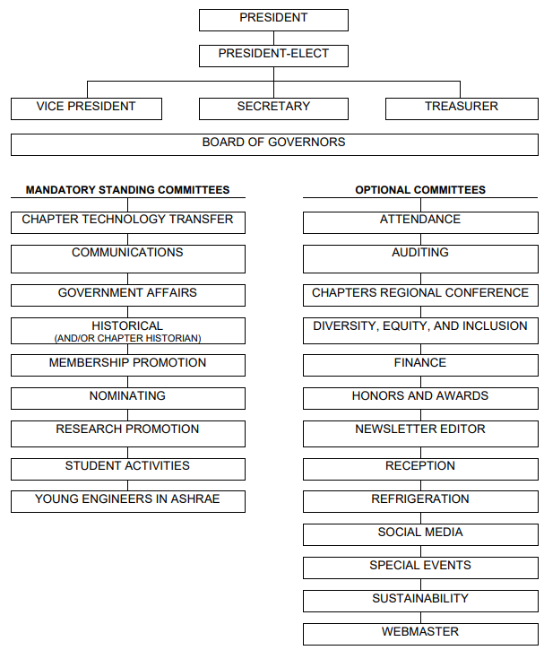
Chapter Committees

Slide 46
Chapter Responsibilities
Chapter Technology Transfer Committee: Monthly Chapter Meetings
Research Promotion Fundraising Goals (Oregon Chapter SY25-16 Goal: $24,500)
Membership Promotion Goals (Grow membership by 3% - approx. 17 new members)
Government Affairs: Engage with government officials
Student Activities: Engage with K-12, and Post-High Students
YEA: Engage with young members (35 and under)
Historical Committee: Maintain chapter history
Chapter must complete audit and file taxes
Attend the Chapters Regional Conference (CRC)
Resources/Benefits:
Support from Regional Leadership Team
Representation/Voting Rights at the CRC
Transportation reimbursement to CRC for delegate, alternate, CTTC, GAC, SA, and YEA chairs
Centralized Training for MP and RP
Chapter dues

Slide 47
Section Organization
ASHRAE Membership
Chapter / Section Membership
No Standing Committees
  CTTC
  RP
  GAC
  MP
  YEA
  SA
  Historical
  Communications
Section Officers:
Elected by members
  Section President
  Section President-Elect
  Section Secretary
  Section Treasurer

Slide 48
Section Responsibilities
Host two meetings per year
  Forward meeting details to Chapter President, DRC and CTTC RVC
Resources:
  Support from Chapter Leadership Team
  No Society-funded transportation reimbursement (Chapter funds may be available)
  No representation/voting rights at CRC

Slide 49
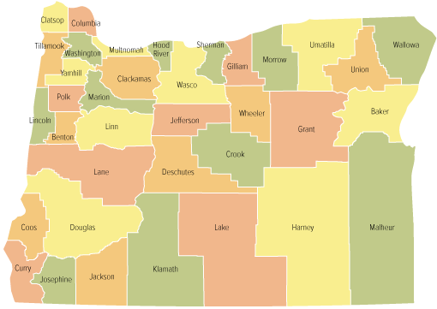
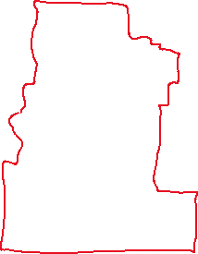
Section Details
Name: The Cascades Section of the Oregon Chapter (Operates under Oregon Chapter Bylaws)
Headquarters: Bend, Oregon
Geographic Area: Counties of Crook, Deschutes, Jefferson, Klamath, and Lake

Slide 50
Section Operations
Sections operates under Society Year:
  Year starts on July 1st
  Year ends on June 30th
  Section Leaders are encouraged to attend the Chapters Regional Conference
Section Officers
  Section President: The Section President shall be the chief executive officer of the Section and shall provide general direction of the affairs of the Section and provide general supervision over its officers.
  Section Vice-President: The Section President-Elect shall automatically succeed to the office of the Section President at the conclusion of the Section President's term of office. In the absence of the Section President, the Section President-Elect shall exercise the powers and perform the duties of the Section President.
  Section Secretary: The Section Secretary shall send notices of meetings to the members and to the Chapter President, Chapter CTTC Chair, CTTC RVC, and DRC. The Section Secretary shall keep minutes of meetings.
  Section Treasurer: The Section Treasurer shall work with the Chapter Treasurer to collect funds for meetings/events and make required payments. The Section Treasurer shall report all transactions to the
  Chapter Treasurer.

Slide 51
Section Operations
Section Representative
  Section Representative shall be appointed by the Chapter President to act as the liaison to the Section and provide support as needed.
Section Officer Elections
  Section officers should be elected by members in accordance with the Chapter Bylaws. The Oregon Chapter bylaws do have specific election criteria for section leaders, so this would fall under the normal election process.
  Nominating Committee would work with the Section to identify candidates. Nominating Committee shall present the list of candidates no later than 30 days before the January meeting. (Oregon ASHRAE Bylaws)
  Nominations can be taken from the floor during the March meeting.
  Elections take place at the April meeting.
  Section Senior Officers (President, Vice-President, and Treasurer) should hold a member grade of Associate or Higher. Section Secretary can hold an Affiliate grade.

Slide 52
Section Operations
Section Meetings
  Sections are required to hold a minimum of two Section Meetings per year. Work with the Chapter CTTC Chair for program ideas. Send announcements to members two weeks in advance of meeting. Program evaluations should be completed.
  Programs MUST conform with ASHRAE’s Commercialism Policy. (Refer to Section 5 of the Manual For Chapter Operations).
  Work with the Chapter CTTC Chair to coordinate ASHRAE Distinguished Lecturer visits.
Special Events
  Coordinate Special Events with Chapter President. Events and any associated sponsorship must comply with ASHRAE’s Commercialism Policy.
  Any events that involve contact sports require additional liability insurance. Coordinate with Chapter President.
  (Axe throwing events are prohibited).
  Refer to ASHRAE’s Alcohol Policy in Section 5 of the Manual for Chapter Operations.

Slide 53
Section Finances
Work with Chapter Treasurer
  Chapter Treasurer manages bank accounts. Section should not have its own bank account.
  Section should work with the Chapter Treasurer to develop an annual budget. The main operating revenue source for the chapter/section is chapter dues. Chapter dues are not separated.
  Provide receipts for all transactions for annual audit.

Slide 54
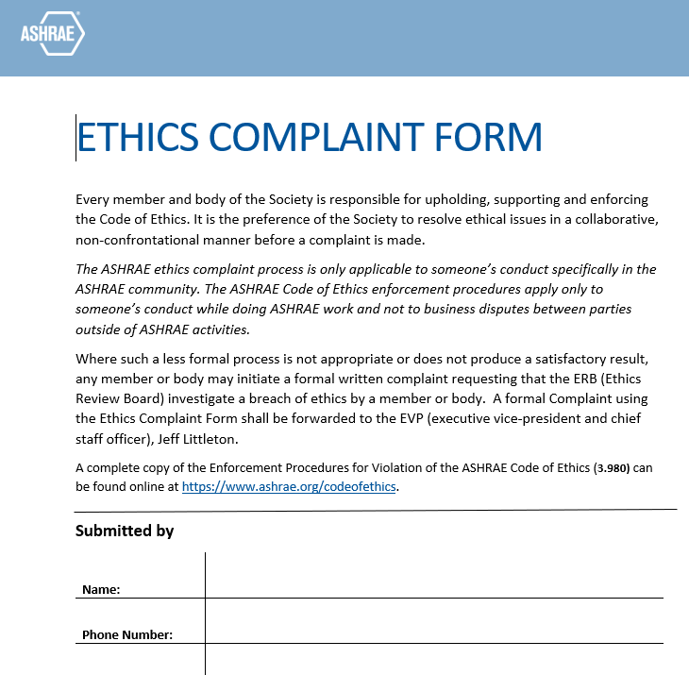
Policies
ASHRAE’s Code of Ethics
  ASHRAE Value Statement: In ASHRAE meetings, we will act with honesty, fairness, courtesy, competence, inclusiveness and respect for others, which exemplify our core values of excellence, commitment, integrity, collaboration, volunteerism and diversity, and shall avoid all real or perceived conflicts of interest. Our culture is one of inclusiveness, acknowledging the inherent value and dignity of each individual. We celebrate diverse and inclusive communities, understanding that doing so fuels better, more creative and more thoughtful ideas, solutions and strategies for the Society and the communities our Society serves. We respect and welcome all.
Reporting Ethics Violations

Slide 55
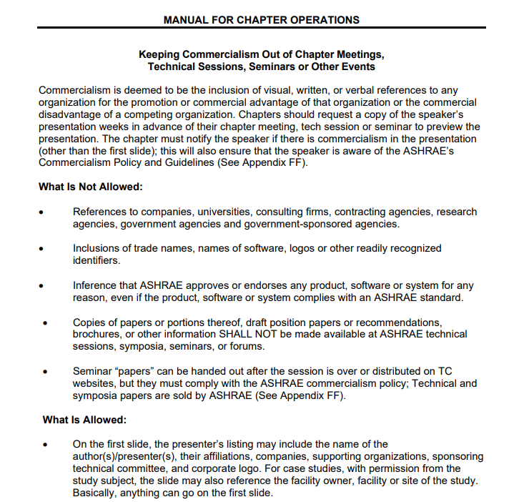

Policies
ASHRAE’s Commercialism Policy

Slide 56

Resources at your fingertips!
ASHRAE Volunteers and Staff
Manuals
  Manual for Chapter Operations
  ASHRAE Rules of the Board
  ASHRAE Bylaws
  Oregon Chapter Bylaws
ASHRAE Website
Other Websites
Training
Notes:
As you can see, there are many different resources available that we will be discussing today. Several items are available on the website, and we will provide links to the ones we discuss today.

Slide 57


Chapter Officers
Know your chapter leadership
Notes:
Who are the first people you go to if you have questions? It would be your chapter officers. Talk with past leaders for insight on what’s been tried in the past, and advice on new fresh ideas.

Slide 58

Regional Officers
Know your regional officers
Attend your CRC
Notes:
There is a regional officer for each chapter position, whose sole purpose is to support YOU, the chapter officers! IF you don’t know who your RVC is, you should be able to find their contact information on your Region’s website.

Slide 59

ASHRAE Staff = Your Link to Society
Notes:
If you run into issues getting information from your chapter and region leaders, ASHRAE staff is another great resource. Every committee has a staff liaison, so if you have a specific question that relates to your committee, you can reach out to that liaison. Or just call the main number and you will be transferred to the right person.

Slide 60

ASHRAE Staff = Your Link to Society
Lizzy Seymour
Director of Member Services
lseymour@ashrae.org
Tammy Catchings
Manager of Regional Activities
tcatchings@ashrae.org
Notes:
If you run into issues getting information from your chapter and region leaders, ASHRAE staff is another great resource. Every committee has a staff liaison, so if you have a specific question that relates to your committee, you can reach out to that liaison. Or just call the main number and you will be transferred to the right person.

Slide 61

Manual for Chapter Operations
Notes:
The Manual for Chapter Operations - This is available on the website, and it is a comprehensive document for you to use as your guide – everything you need to know to manage your chapter, including a chapter dedicated to the roles and responsibilities for each chapter officer.

Slide 62

Chapter Bylaws
Notes:
However, every chapter has it’s own set of bylaws.
How many people have seen your chapters bylaws? – raise your hand using the reactions – Not very many…
If you do not have the latest version, reach out to your Chapter Leaders, or Past leaders to track it down.
The Bylaws will dictate specific details on how your chapter operates. Review your bylaws! If they are significantly out of date, and they most likely do not include how to operate virtually in a pandemic, it’s probably time to update them.

Slide 63
Region Operations Manual
Notes:
Regional Operations Manual - It’s just like the Manual of Chapter Operations but for the Region Operations – if you are interested in serving on a regional capacity – this details roles and responsibilities for the RVCs

Slide 64
ASHRAE Rules of the Board
Principles and Policies
Standing Rules
Manuals and Procedures
Operation and Administration
Notes:
ASHRAE Rules of the Board - This covers EVERYTHING about ASHRAE operation from the society, region, and chapters, to staff as well. This can be found on the website.

Slide 65
ASHRAE Bylaws
Organization
Membership
  Membership Grades
Meetings of Members
  Winter, Annual, & Special
Board of Directors
Officers
Councils
Committees
Notes:
ASHRAE Bylaws - It’s another one of ASHRAE’s governing documents that covers things like dues, member grades, Conferences, and a brief description of the responsibilities of the officers.
This is the one document where membership grades are defined.

Slide 66

www.ashrae.org
Notes:
Navigate:
ASHRAE Homepage
CONFERENCES: “check this website regularly, it will be populated and if you are interested in getting involved in a TC or Standards committee you can find information on when they are meeting so that you can attend the meeting.”
If you want to speak at a conference, the next opportunity would be the Annual Conference in Toronto – deadline to submit an abstract is Feb 17th! You can browse the list of track topics and summaries here. If you need some guidance on how to get a program accepted, reach out to one of us facilitators and we’d be happy to walk you through the process.
ASHRAE.org – Communities – Committees – Standing Committees - Communications – resources on how to hold a virtual meeting, basecamp, and how to manage your website
Nominations – I just typed nominations in the search bar, and it took me here – You’ll see the different committees you can nominate yourself to
“Standing Committee Job Descriptions” – When I wanted to get more involved at the society level, my boss went through this list with me, and we discussed what each committee did, and the time commitments. If you are curious, there are detailed descriptions, and also ask another society volunteer and we could probably help you find a good fit.
ASHRAE.org – Technical Resources – Technical Committees - how to join a tc - show a TC website
ASHRAE.org – Communities – Chapters - DL program
BASECAMP

Slide 67





Other Websites
Basecamp
Membership Promotion
Research Promotion
Regional Websites
Chapter Websites
TC Websites
LinkedIn
Facebook
YouTube
Instagram
Technology Portal
Notes:
Other useful websites include:
Basecamp – many society and regional committees utilize Basecamp to exchange and share documents and communicate.
Membership Promotion Website – content from centralized training – not to replace centralized training, but the place you refer to as a refresher
Research Promotion – also has a website
Regional Websites – Information regarding the Region Operations, Regional Officers with contact information, and Updates on your CRC.
Chapter Websites – If you need information about your own chapter, this is a great place to start. Make sure this is updated for your members. Also, if you want to outreach and coordinate meetings/events with other chapters, you can typically find contact information for their board members on their website.
TC Websites – You can see what they are working on, read through meeting minutes, and get a better sense of what that TC does
ASHRAE is on several social media channels like LinkedIn, Facebook, YouTube, and more recently added Instagram. You can share the content from the ASHRAE pages to your chapter social media accounts

Slide 68

Basecamp

Slide 69

Running Reports

Slide 70


Training – Attend your CRC!!
Training Workshops
Business Meetings
  Motions
  Chapter Reports
Awards
Notes:
We already talked about CRC, just a reminder, this is where a lot of the trainings occur

Slide 71
Next Steps
Planning for the rest of Society Year 25-26
  Meetings/Events
  Finances
Planning for Society Year 26-27
  Officers
  Meetings/ Events
  CRC Attendance
  Chapter/Regional Leader Visits

Slide 72
Next Steps
Formation of the Cascades CHAPTER requirements
  Can apply to be a Chapter after a minimum of two years operating as a section in good standing*
  The Oregon Chapter should have net positive growth for at least three years prior to application
  Requires written petition of a minimum of 40 Full Members/Associates in good standing
  Adoption of the Constitution and Bylaws
Process
  The Section leaders shall initiate discussions with the DRC.
  After paperwork is completed, the DRC and RMCR will submit a formal request to Members Council
  If the petition is approved by Members Council at their next meeting, it will go to the Board of Directors for final vote at their next meeting.

Slide 73

Next Steps
Appendix 11H: Section Becoming a Chapter

Slide 74
Thank you!
Questions or Comments?

